Slide 1
Deep Learning for Epidemiological Predictions
Presented by Landon Fox
Researched and developed by Yuexin Wu et al.

Slide 2
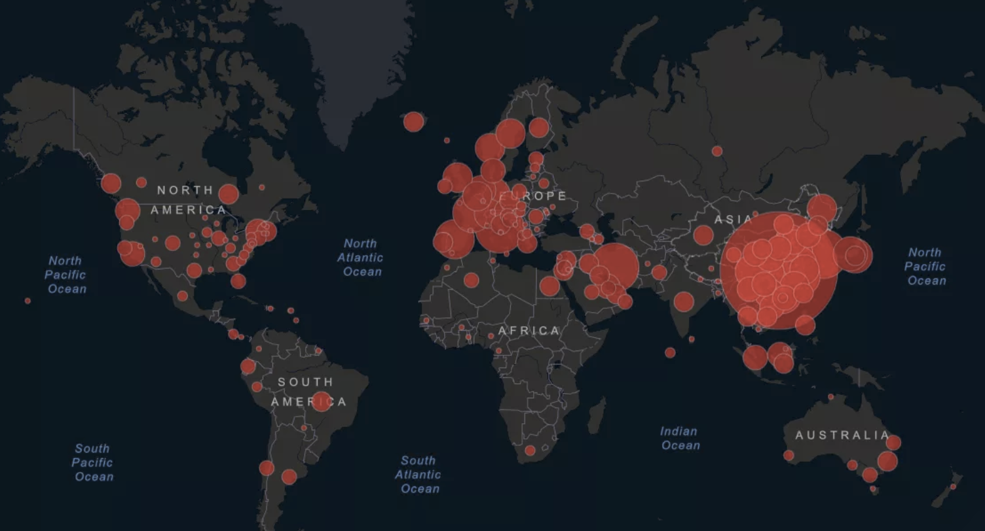
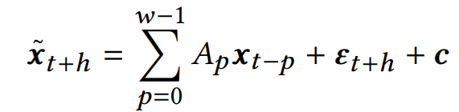
Introduction and Background
As a result of the Covid-19 pandemic, the importance of this issue is well known to us all. Forecasting peak intensity and outbreak time is essential.
To aid the prediction of epidemics, the first ever epidemiological deep learning architecture is developed.
Up until the time of this work, only time-series methodologies such as Autoregressive (AR) models, Gaussian Process Regression (GPR), and similar have been utilized in epidemiology.
While each methodology has an advantage, none properly account for geographic location without extremely complex models.
Vector Autoregressive (VAR) future profile.
Covid-19 outbreak as of March 10, 2020 (CSSE)

Slide 3
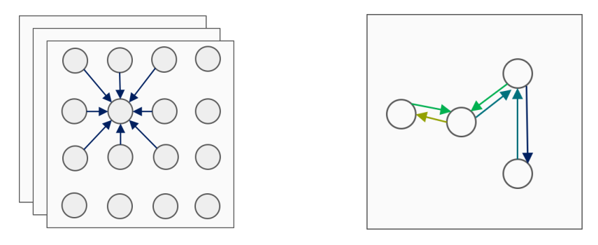

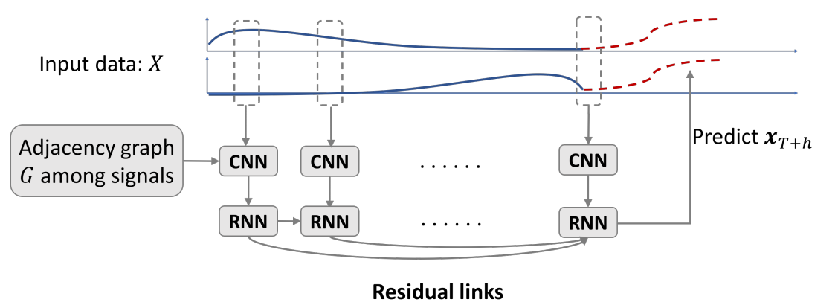
Methodology and Implementation
CNN filter and a locational adjacency filter
Transformed feature map from CNN
With a time-series formulation, we are provided a collection of multivariate epidemiology profiles over a time period and wish to predict the profile at a later time. An example may include a 50 -dimensional vector representing the number of influenza patients within our 50 states at a given time.
A CNN, RNN, and residual module are utilized at each unit of time so that all important features are expressed, temporal data is accounted for, and overfitting is avoided.
Since our data is not grid-like, unlike an image, we modify our CNN filter to be induced by the graph encoding geographic locations and take the nearest neighbors in the graph.
Proposed architecture

Slide 4
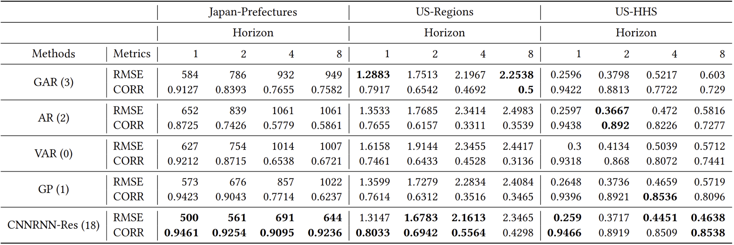
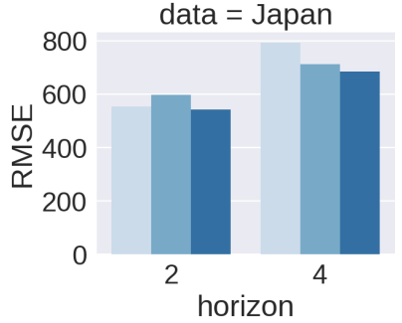
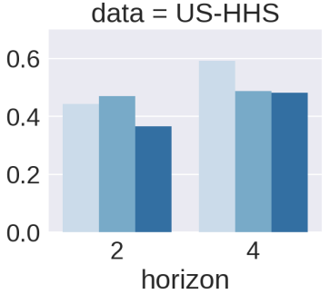
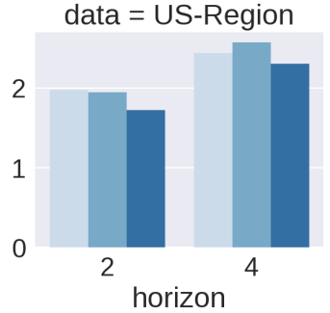
Experiment and Results
The architecture (CNNRNN-Res) is compared against well adopted linear models AR, Global AR (GAR), Vector AR (VAR) as well as a nonlinear model, GPR.
Three data sets are used: Japan-Prefectures, US-Regions, and the US-HHS, all depicting influenza activity levels around the time of 2009-2015.
The following table illustrates the best results in bold. We can see that the proposed architecture is more desirable in regard to both error metrics.
Performance comparison amongst models currently used in epidemiology
Ablation tests

Slide 5

Conclusion
Being the first of its kind, this architecture provides a more sophisticated approach to epidemiological modeling.
What makes this architecture unique, is its use of CNN, RNN, and residual modules to encode all relevant information such as temporal data in the RNN as well as geographic data via a locational graph representation in the CNN.
Finally, in regard to performance, we have seen that it has the highest success rate when predicting the horizon.
Dr. Yuexin Wu, lead author

Slide 6
References
Yuexin Wu, Yiming Yang, Hiroshi Nishiura, and Masaya Saitoh. 2018. Deep Learning for Epidemiological Predictions. In The 41st International ACM SIGIR Conference on Research & Development in Information Retrieval (SIGIR '18). Association for Computing Machinery, New York, NY, USA, 1085–1088. DOI:https://doi.org/10.1145/3209978.3210077

